Slide 1
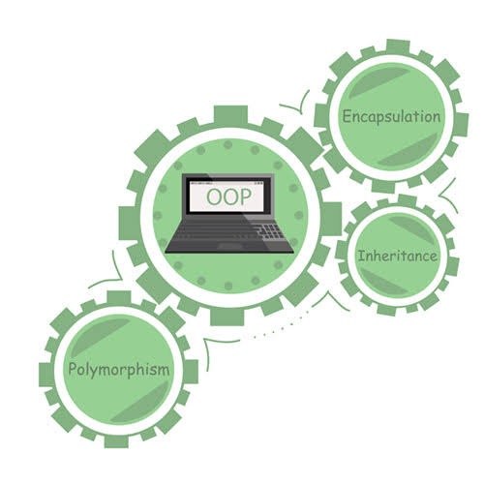

Object Oriented Paradigm
Topic: JAVA
Inheritance and
Polymorphism

Slide 2

Contents - Inheritance
Rules of Inheritance in JAVA
Method Overloading and Overriding
Doubt: transient modifier
Revision

Slide 3
RULE 1: Multiple Inheritance is NOT permitted in Java
Class A is a parent class for Class B and C.
Class A
Class D has properties from A, B and C.
Multiple inheritance is not supported in Java but you can still achieve it using interfaces.
Class B
Class C
Now, we have……
Show()
Different Functionalities
Show()
Diamond Problem
Class D
Now, when you try to invoke show() of class B, the compiler will get confused as to which show() to be invoked ( either from class B or class C ). Hence it leads to ambiguity.
Show()
Show()

Slide 4
Rules of Inheritance in JAVA
RULE 1: Multiple Inheritance is NOT permitted in Java.
RULE 2: Cyclic Inheritance is NOT permitted in Java.
RULE 3: Private members do NOT get inherited.
RULE 4: Constructors cannot be Inherited in Java.
RULE 5: In Java, we assign parent reference to child objects.
RULE 6: Constructors get executed because of super() present in the constructor.

Slide 5
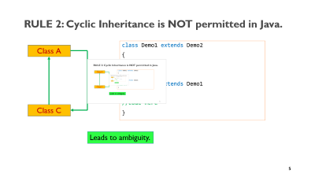
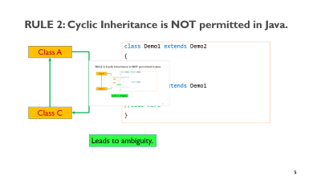
RULE 2: Cyclic Inheritance is NOT permitted in Java.
class Demo1 extends Demo2
{
//code here
}
class Demo2 extends Demo1
{
//code here
}
Class A
Class C
Leads to ambiguity.

Slide 6
RULE 3: Private members do NOT get inherited.
class Launch
{
public static void main(String args[])
{
Friend f = new Friend();
f.changeData();
//f.disp();
}
}
class You
{
private int an;
private int pw;
You{
an =111;
pw= 222;
}
}
class Friend extends You
{
void changeData()
{
an =8888;
pw=9999;
}
}
error: an has private access in You an =8888; error: pw has private access in You pw=9999;
Private variables: pw and an will not be inherited.
They are specific to the particular class.

Slide 7
RULE 4: Constructors cannot be Inherited in Java.
class A {
A();
}
class B extends A{
B();
}
A constructor cannot be inherited, as the subclasses always have a different name.
You can do only:
B b = new B(); // and not new A()
You can still use constructors from A inside B’s implementation though:
class B extends A{
B() {
super();
}
}

Slide 8
RULE 5: In Java, we assign parent reference to child objects.
public class Parent {
-----------------
String getEmployeeDetails() {
return "Name: " + name;
}
}
public class Child extends Parent {
-----------------
@Override
public String getEmployeeDetails() {
return "Name: " + name + " Salary: " + salary;
}
}
Parent parent = new Parent();
parent.name = 1;
Child child = new Child();
child.name = 2;
child.salary = 2000;
Parent[] employees = new Parent[] { parent, child };
for (Parent employee : employees) {
employee.getEmployeeDetails();
}
Child object is stored in parent reference.

Slide 9
RULE 6: Constructors get executed because of super() present in the constructor.
Constructors do not get inherited, but it gets executed because of the super() keyword.
Class A{
A(){
----------
}
}
Class B extends A{
B(){
super();
}
}

Slide 10
Constructors in Java
In Java, a constructor is a block of codes similar to the method. It is called when an instance of the class is created.
At the time of calling constructor, memory for the object is allocated in the memory.
It is a special type of method which is used to initialize the object.
Every time an object is created using the new() keyword, at least one constructor is called.

Slide 11
Rules for creating Java constructor
There are two rules defined for the constructor.
Constructor name must be the same as its class name
A Constructor must have no explicit return type
A Java constructor cannot be abstract, static, final, and synchronized

Slide 12
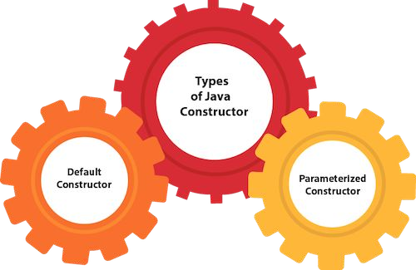

Slide 13
Java Default Constructor
A constructor is called "Default Constructor" when it doesn't have any parameter.
Syntax of default constructor:
<class_name>()
{ }

Slide 14
public class Bike1
{
Bike1()
{
System.out.println("Bike is created");
}
public static void main(String args[])
{
Bike1 b=new Bike1();
}
}
Bike is created

Slide 15
Java Parameterized Constructor
A constructor which has a specific number of parameters is called a parameterized constructor.
Why use the parameterized constructor?
The parameterized constructor is used to provide different values to distinct objects.
However, you can provide the same values also.

Slide 16
class Rectangle
{
int area, length, breadth;
// Parameterized constructor Rectangle(int l, int b)
{
length = l; breadth = b;
}
void getArea()
{
area = length * breadth; System.out.println("Area of rectangle : " + area);
}
}

Slide 17
public class FindArea
{
public static void main(String[] args)
{
Rectangle rs = new Rectangle(10, 20); rs.getArea();
}
}

Slide 18
Constructor Overloading in Java
In Java, a constructor is just like a method but without return type.
It can also be overloaded like Java methods.
Constructor overloading in Java is a technique of having more than one constructor with different parameter lists.
They are arranged in a way that each constructor performs a different task.
They are differentiated by the compiler by the number of parameters in the list and their types.

Slide 19
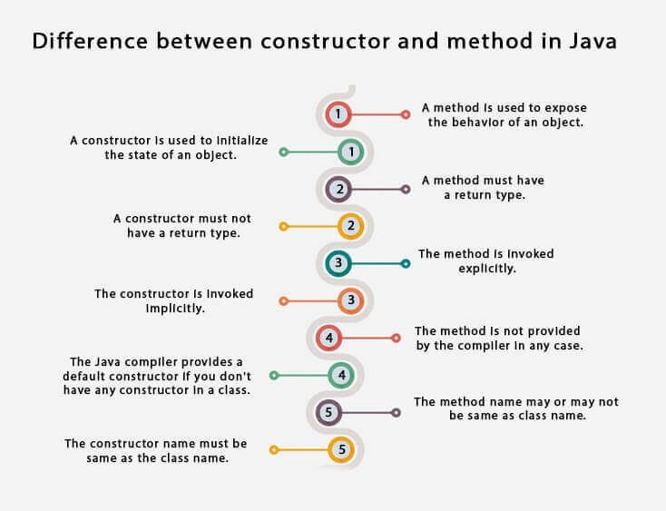

Slide 20
What is Polymorphism?
Polymorphism means many forms.
In Java, polymorphism allows:
Same method name
Different behavior
Depending on object type or arguments
Real-world example: A person can be a teacher, parent, or employee at different times.

Slide 21
Polymorphism in Java
Java supports polymorphism using:
Method Overloading
Method Overriding
Parent reference → Child object
Parent p = new Child();
p.show(); // Child's method is called
✔ Method call depends on object, not reference type
Here, reference type is Parent. This decides:
Which variables can be accessed
Which methods are visible at compile time

Slide 22
Step 1: Compile time
Compiler sees reference type → Parent
Checks whether show() exists in Parent ✔ Yes → compilation successful
Step 2: Runtime (REAL MAGIC)
JVM sees actual object → Child
Child has its own version of show() ✔ JVM calls Child's show()

Slide 23
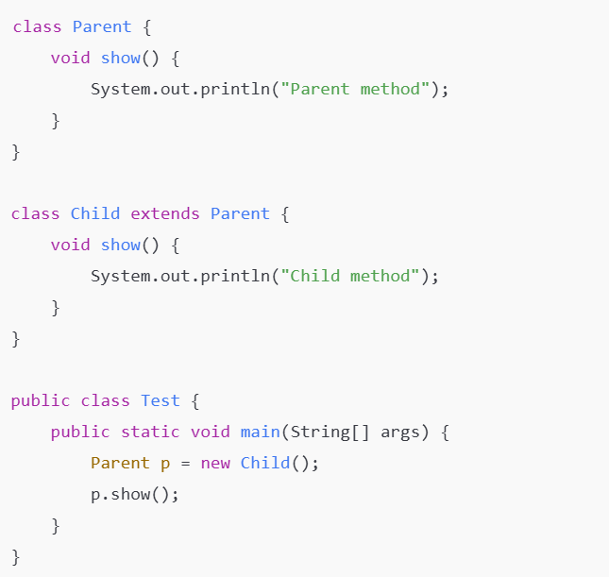
Output: Child method

Slide 24
Types of Polymorphism
Compile-Time Polymorphism
Achieved using Method Overloading
Method call resolved at compile time
Run-Time Polymorphism
Achieved using Method Overriding
Method call resolved at runtime

Slide 25
Method Overloading & Overriding
Method overloading is a feature that allows a class to have more than one method having the same name, if their argument lists are different.
Three types:
Number of parameters
Data type of the parameters
Sequence of the data type of the parameters
Rules:
We cannot overload a return type.
Although we can overload static methods, the arguments or input parameters have to be different.
We cannot overload two methods if they only differ by a static keyword.
Like other static methods, the main() method can also be overloaded.

Slide 26
Overloading
Method (int x)
Number of parameters
Same Class
Method (int x, int y)
Data type of the parameters
Method (float x, int y)
Sequence of the data type of the parameters
Method (int x, float y)

Slide 27
Example
Why Method Overloading?
public class Div{
public int div(int a , int b){
return (a / b); }
public int div(int a , int b , int c){
return ((a + b ) / c); }
public static void main(String args[]){
Div ob = new Div();
ob.div(10 , 2);
ob.div(10, 2 , 3);
}
}
It gives us the liberty to not define a function again and again for doing the same thing.
In example: the two methods are basically performing division.

Slide 28
Overloading the main() method
public class Example{
public static void main(String[] args){
System.out.println(“Hello");
Example.main(“Students");
}
public static void main(String arg1){
System.out.println(" Welcome" + arg1);
Example.main(“Welcome" , "to JAVA");
}
public static void main(String arg1 , String arg2){
System.out.println(“Hi" , +arg1 , +arg2);
}
}
Hello welcome Students
Hi Welcome to JAVA

Slide 29
Overloading static Methods
public class Test{
public static int func(int a ){
return 100;
}
public static String func(int a , int b){
return “JAVA";
}
public static void main(String args[]){
System.out.println(func(1));
System.out.println(func(1,3));
}
}
✔ Static → no object required to call
Parameter list is different → valid overloading
100
JAVA

Slide 30
What is super Keyword in Java?
super refers to the immediate parent class object.
It is mainly used when:
Parent and child class have same variable names
Parent and child class have same method names
We want to call the parent constructor
When is it needed?
When child class has a variable with same name as parent class.

Slide 31
Super Keyword
The super keyword refers to superclass (parent) objects.
It is used to call superclass methods, and to access the superclass constructor.
The most common use of the super keyword is to eliminate the confusion between superclasses and subclasses that have methods with the same name.
super can be used to refer immediate parent class instance variable.
super can be used to invoke immediate parent class method.
super() can be used to invoke immediate parent class constructor.

Slide 32
class Parent {
int x = 10;
}
class Child extends Parent {
int x = 20;
void show() {
System.out.println("Child x: " + x);
System.out.println("Parent x: " + super.x);
}
}
public class Test {
public static void main(String[] args) {
Child c = new Child();
c.show();
}
}
Output: Child x: 20
Parent x: 10
super.x refers to parent class variable.

Slide 33
1) super is used to refer immediate parent class instance variable.
We can use super keyword to access the data member or field of parent class.
It is used if parent class and child class have same fields.

Slide 34
class Animal{
String color="white";
}
class Dog extends Animal{ String color="black";
void printColor(){ System.out.println(color);//prints color of Dog class
System.out.println(super.color);//prints color of Animal class
}
}
class TestSuper1{
public static void main(String args[]){ Dog d=new Dog();
d.printColor();
}
}

Slide 35
2) super can be used to invoke parent class method
The super keyword can also be used to invoke parent class method.
It should be used if subclass contains the same method as parent class.
In other words, it is used if method is overridden

Slide 36
class Animal
{
void eat()
{
System.out.println("eating...");
}
}
class Dog extends Animal
{
void eat()
{
System.out.println("eating bread...");
}
void bark()
{
System.out.println("barking...");
}

Slide 37
void work()
{
super.eat();
bark();
}
}
class TestSuper2
{
public static void main(String args[])
{
Dog d=new Dog(); d.work();
}
}
super.eat(); → calls Animal's eat()
bark(); → calls Dog's bark()

Slide 38
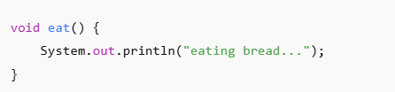
Output: eating…
barking...
Even though Dog overrides eat():
main()
↓
Dog d = new Dog()
↓
d.work()
↓
---------------------------------
| Dog Class |
|-------------------------------|
| work() |
| ↓ |
| super.eat() ----------------------→ Animal.eat()
| ↓ prints "eating..."
| bark() → prints "barking..." |
---------------------------------
super.eat() forces the JVM to call:
Animal.eat()
If super is removed
eating bread...
barking...

Slide 39
3) super is used to invoke parent class constructor.
The super keyword can also be used to invoke the parent class constructor.
Let's see a simple example:

Slide 40
class Animal
{
Animal()
{
System.out.println("animal is created");
}
}
class Dog extends Animal
{
Dog()
{
super();
System.out.println("dog is created");
}
}

Slide 41
class TestSuper3
{
public static void main(String args[])
{
Dog d=new Dog();
}
}
Output:
animal is created
dog is created

Slide 42
final Keyword In Java
The final keyword in java is used to restrict the user.
The java final keyword can be used in many context. Final can be:
variable
method
class
The final keyword can be applied with the variables, a final variable that have no value it is called blank final variable or uninitialized final variable.

Slide 43
1) Java final variable
If you make any variable as final, you cannot change the value of final variable
(It will be constant)
final int speedlimit=90;//final variable

Slide 44
2) Java final method
If you make any method as final, you cannot override it.
final void run()
{
System.out.println("running");
}

Slide 45
3) Java final class
If you make any class as final, you cannot extend it.
class Bike{}
final class Honda1 extends Bike{
void run()
{
System.out.println("running safely with 100kmph");
}
public static void main(String args[])
{
Honda1 honda= new Honda1(); honda.run();
}
}

Slide 46
Method Overriding
Inheritance in java involves a relationship between parent and child classes. Whenever both the classes contain methods with the same name and arguments or parameters it is certain that one of the methods will override the other method during execution. The method that will be executed depends on the object.
If the child class object calls the method, the child class method will override the parent class method. Otherwise, if the parent class object calls the method, the parent class method will be executed.

Slide 47
Example
class Parent{
void view(){
System.out.println("this is a parent class method”);
}
}
class Child extends Parent{
void view(){
System.out.println("this is a child class method”);
}
}
Public class Example{
public static void main(String args[]){
Parent ob = new Parent();
ob.view();
Child ob1 = new Child();
ob1.view();
}
}

Slide 48
Program to show overriding using super keyword
class Parent {
void show(){
System.out.println("parent class method");
} }
class Child extends Parent {
void show(){
super.show();
System.out.println("child class method");
}
public static void main(String args[]){
Parent ob = new Child();
ob.show();
}
}
parent class method
child class method

Slide 49
Rules
The access modifier can only allow more access for the overridden method.
A final method does not support method overriding.
A static method cannot be overridden.
Private methods cannot be overridden.
The return type of the overriding method must be the same.
We can call the parent class method in the overriding method using the super keyword.
A constructor cannot be overridden because a child class and a parent class cannot have the constructor with the same name.

Slide 50
Key Difference
Feature | Overloading | Overriding
Class | Same class | Parent–child classes
Parameters | Must differ | Must be same
Inheritance | Not required | Required
Polymorphism | Compile-time | Run-time
Method call decided | Compiler | JVM

Slide 51
Method Overloading | Method overriding
It is used to increase the readability of the program | Provides a specific implementation of the method already in the parent class
It is performed within the same class | It involves multiple classes
Parameters must be different in case of overloading | Parameters must be same in case of overriding
Is an example of compile-time polymorphism | It is an example of runtime polymorphism.
Return type can be different but you must change the parameters as well. | Return type must be same in overriding
Static methods can be overloaded | Overriding does not involve static methods.

Slide 52
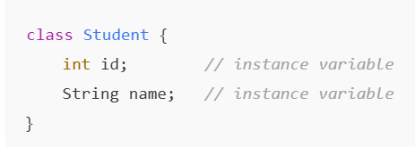
Class Instance Variables
Instance variables are variables that:
Are declared inside a class
But outside methods / constructors
Belong to objects, not the class

Slide 53
Characteristics of Instance Variables
Created when object is created
Destroyed when object is destroyed
Each object gets separate copy
objects are Stored in Heap memory; Instance variables are stored inside the object;Local variables are stored in Stack memory
Have default values
Data Type | Default Value
int | 0
float | 0.0
boolean | false
object | null

Slide 54
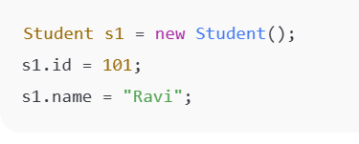
Accessing Instance Variables
Instance variables are accessed using object reference.
Cannot be accessed directly inside static method without object.

Slide 55
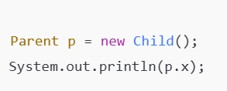
Instance Variables vs Local Variables
Instance Variable | Local Variable
Declared in class | Declared in method
Stored in Heap | Stored in Stack
Default value exists | No default value
Object dependent | Method dependent
Instance Variables and Polymorphism
- Instance variables do NOT support polymorphism
Variable access depends on reference type Method access depends on object type
Because variables are not overridden — they are hidden.

Slide 56
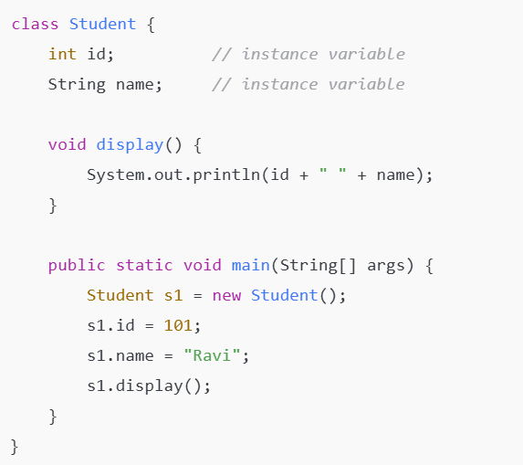
Basic Instance Variables
id and name belong to the object s1, not to the class.

Slide 57
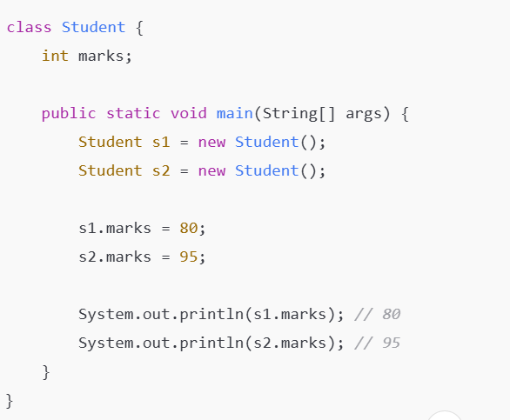
Each Object Has Its Own Copy

Slide 58
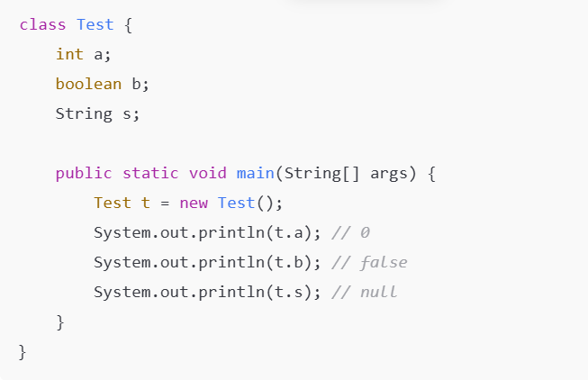
Default Values of Instance Variables
Instance variables always get default values.

Slide 59
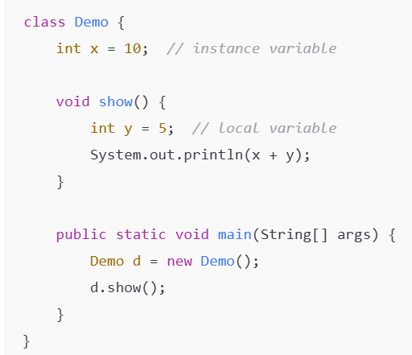
Instance Variable vs Local Variable
Local variables must be initialized, instance variables need not.

Slide 60
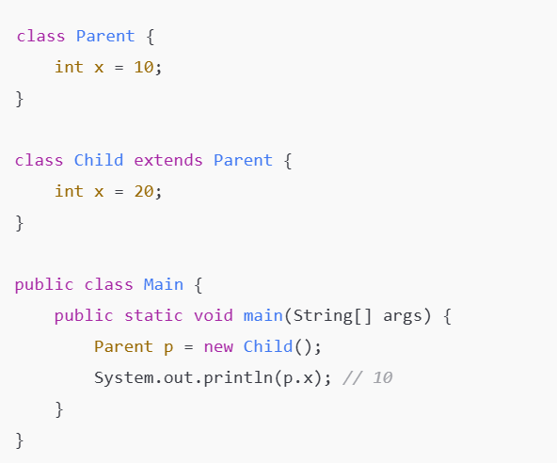
Instance Variables & Polymorphism
Real Advantage of Instance Variables
✔ Maintain object state ✔ Share data between methods ✔ Store real-world properties ✔ Lifetime tied to object
Instance variables depend on reference type, not object type.

Slide 61
What is Garbage Collector?
Garbage Collector (GC) is an automatic memory management system in Java.
It:
Identifies unused objects
Frees heap memory
Prevents memory leaks
Programmer cannot delete objects manually

Slide 62
Garbage Collection Process
1️⃣ Object created → stored in heap 2️⃣ Object used by program 3️⃣ Reference removed 4️⃣ GC identifies unused object 5️⃣ Memory reclaimed
GC runs automatically, not immediately
Mark and Sweep (Basic Algorithm)→Mark Phase and Sweep Phase Mark and Compact Improved version →Avoids fragmentation

Slide 63

Can We Force Garbage Collection?
No, we cannot force it.
We can only request JVM
JVM decides whether to run GC or not

Slide 64
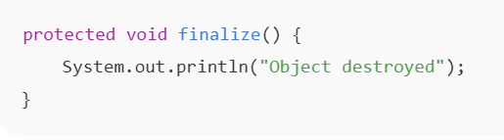
finalize() Method (Conceptual)
finalize() is a method that is called by the Garbage Collector before an object is removed from memory
When is it called?
Object becomes unreachable
GC decides to remove it
Before reclaiming memory,
JVM may call finalize()
⚠ Not guaranteed to execute
Because:
GC may not run immediately
Program may end before GC runs
JVM may ignore it
So you cannot rely on finalize() for important cleanup.
finalize() is deprecated in modern Java9+

Slide 65
Instance Variables & GC – Relation
Instance variables are stored in heap
When object is destroyed → instance variables also removed
GC clears entire object memory

Slide 66
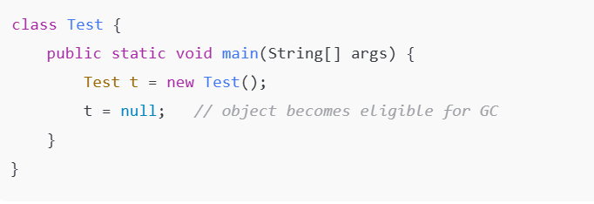
Object Eligible for Garbage Collection
No reference → object is ready for garbage collection.

Slide 67
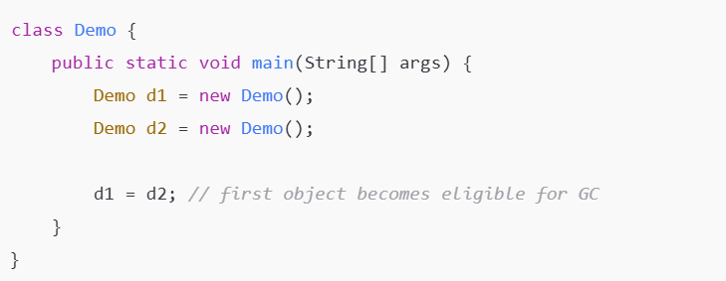
Reassigning Reference
Old object loses reference → GC candidate.

Slide 68
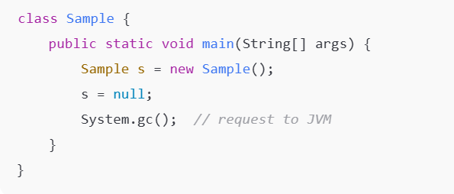
Garbage Collection Request
GC may or may not run.

Slide 69
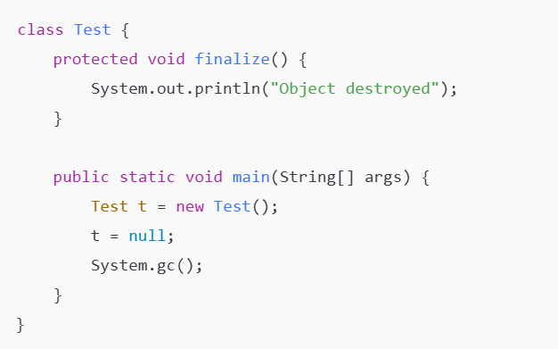
finalize() Method
finalize() is not guaranteed to execute.

Slide 70
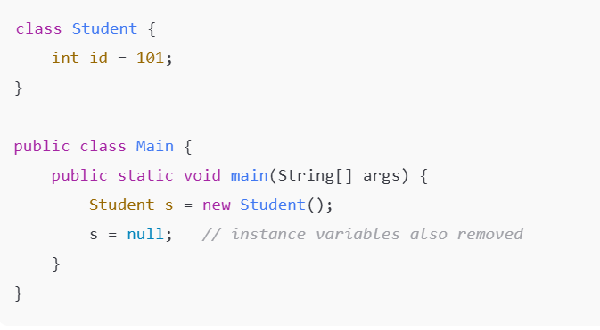
Instance Variables + GC Together
When object is destroyed → instance variables are destroyed too.

Slide 71
THANK YOU….

